Slide 1
COMP2068 – JavaScript Frameworks
Lesson 2
Closures & NPM

Slide 2
Lesson Objectives
In this Lesson we will learn about:
Closure structures in JavaScript
Node Package Manager (NPM)

Slide 3
Intro to Closures
Last week we looked at some new strange syntax in JS, where we assigned a variable to a function:
let food = fs.readFile('food.txt', 'utf8', (err, data) => {
console.log(data)
})
This structure is called a Closure and it’s vital to asynchronous code in Node

Slide 4
What is a Closure?
A function referencing variables from parent environment
function parent() {
let message = 'Hello World';
function child() {
console.log (message);
}
child();
}
parent();
child() can access variables from parent()

Slide 5
Assigning a Variable to a Closure
function parent() {
let message = 'Hello World'
function child() {
console.log (message)
}
return child
}
let childFunction = parent()
childFunction()
Closure: a function AND its environment, including its variables
This allows us to pass functions with their variables as arguments to other functions
So What?

Slide 6

Closures & the Node Event Loop
Source: https://www.youtube.com/watch?v=GJmFG4ffJZU

Slide 7
Introducing NPM
Node.js is a platform, which means its features and APIs are kept to a minimum.
To achieve more complex functionality, it uses a module system that allows you to extend the platform.
The best way to install, update, and remove Node.js modules is using the NPM (Node Package Manager).
NPM has the following main features:
A registry of packages to browse, download, and install third-party modules
A CLI tool to manage local and global packages

Slide 8
Using NPM
Installing a package using NPM
Once you find the right package, you'll be able to install it using the npm i command as follows:
$ npm i <Package Unique Name>
Installing a module globally is similar to its local counterpart, but you'll have to add he –g flag as follows:
$ npm i –g <Package Unique Name>
For example, to locally install Express, you'll need to navigate to your application folder and issue the following command:
$ npm i express

Slide 9
Using NPM (cont’d)
The preceding command will install the latest stable version of the Express package in your local node_modules folder.
Furthermore, NPM supports a wide range of semantic versioning, so to install a specific version of a package, you can use the npm i command as follows:
$ npm i <Package Unique Name>@<Package Version>
For instance, to install the latest major version of the Express package, you'll need to issue the following command:
$ npm i express --save

Slide 10
Using NPM (cont’d)
Removing a package using NPM
To remove an installed package, you'll have to navigate to your application folder and run the following command:
$ npm uninstall < Package Unique Name>
NPM will then look for the package and try to remove it from the local node_modules folder.
To remove a global package, you'll need to use the -g flag as follows:
$ npm uninstall –g < Package Unique Name>

Slide 11
Using NPM (cont’d)
Updating a package using NPM
To update a package to its latest version, issue the following command:
$ npm update < Package Unique Name>
NPM will download and install the latest version of this package even if it doesn’t exist yet.
To update a global package, use the following command:
$ npm update –g < Package Unique Name>

Slide 12
Managing dependencies using the package.json file
Installing a single package is nice, but pretty soon, your application will need to use several packages, and so you'll need a better way to manage these package dependencies.
For this purpose, NPM allows you to use a configuration file named package.json in the root folder of your application.
In your package.json file, you'll be able to define various metadata properties of your application, including properties such as the name, version, and author of your application.
This is also where you define your application dependencies.

Slide 13
Managing dependencies using the package.json file (cont’d)
The package.json file is basically a JSON file that contains the different attributes you'll need to describe your application properties.
An application using the latest Express and Grunt packages will have a package.json file as follows:
{
"name" : "MEAN",
"version" : "0.0.1",
"dependencies" : {
"express" : "latest",
"grunt" : "latest"
}
}

Slide 14
Managing dependencies using the package.json file (cont’d)
Creating a package.json file
While you can manually create a package.json file, an easier approach would be to use the npm init command. To do so, use your command-line tool and issue the following command:
$ npm init
NPM will ask you a few questions about your application and will automatically create a new package.json file for you.
A sample process should look similar to the following screenshot:

Slide 15
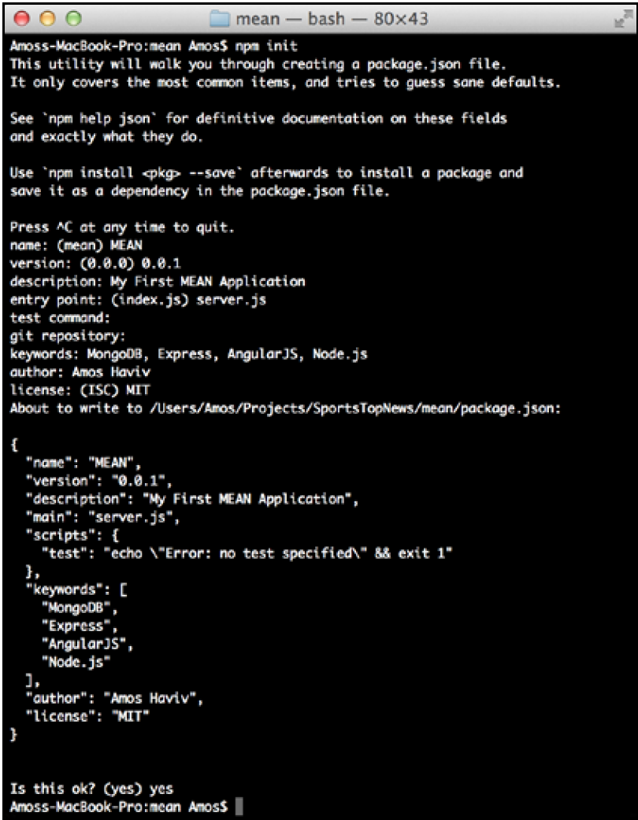
Managing dependencies using the package.json file (cont’d)
A sample process should look similar to the following screenshot:

Slide 16
Managing dependencies using the package.json file (cont’d)
Installing the package.json dependencies
After creating your package.json file, you'll be able to install your application
dependencies by navigating to your application's root folder and using the npm install command as follows:
$ npm i
NPM will automatically detect your package.json file and will install all your application dependencies, placing them under a local node_modules folder.
An alternative and sometimes better approach to install your dependencies is to use the following npm update command:
$ npm update
This will install any missing packages and will update all of your existing dependencies to their specified version.

Slide 17
Managing dependencies using the package.json file (cont’d)
Updating the package.json file
Another robust feature of the npm i command is the ability to install a new package and save the package information as a dependency in your package.json file.
This can be accomplished using the --save optional flag when installing a specific package.
For example, to install the latest version of Express and save it as a dependency, you can issue the following command:
$ npm i express --save

Slide 18
Node Modules
JavaScript has turned out to be a powerful language with some unique features that enable efficient yet maintainable programming.
Its closure pattern and event-driven behavior have proven to be very helpful in real-life scenarios, but like all programming languages, it isn't perfect, and one of its major design flaws is the sharing of a single global namespace.
This could have been a major threat for Node.js evolution as a platform, but luckily a solution was found in the CommonJS modules standard.

Slide 19
CommonJS Modules
CommonJS is a project started in 2009 to standardize the way of working with JavaScript outside the browser.
The project has evolved since then to support a variety of JavaScript issues, including the global namespace issue, which was solved through a simple specification of how to write and include isolated JavaScript modules.
The CommonJS standards specify the following three key components when
working with modules:
require(): This method is used to load the module into your code.
exports: This object is contained in each module and allows you to expose pieces of your code when the module is loaded.
module: This object was originally used to provide metadata information about the module. It also contains the pointer of an exports object as a property. However, the popular implementation of the exports object as a standalone object literally changed the use case of the module object.

Slide 20
CommonJS Modules (cont’d)
In Node's CommonJS module implementation, each module is written in a single JavaScript file and has an isolated scope that holds its own variables.
The author of the module can expose any functionality through the exports object.
To understand it better, let's say we created a module file named hello.js that contains the following code snippet:
let message = 'Hello';
exports.sayHello = function(){
console.log(message);
}

Slide 21
CommonJS Modules (cont’d)
Also, let's say we created an application file named server.js, which contains the following lines of code:
let hello = require('./hello');
hello.sayHello();
In the preceding example, you have the hello module, which contains a variable named message.
The message variable is self-contained in the hello module, which only exposes the sayHello() method by defining it as a property of the exports object.
Then, the application file loads the hello module using the require() method, which will allow it to call the sayHello() method of the hello module.

Slide 22
Node.js Core Modules
Core modules are modules that were compiled into the Node binary.
They come prebundled with Node and are documented in great detail in its documentation.
The core modules provide most of the basic functionalities of Node, including filesystem access, HTTP and HTTPS interfaces, and much more.
To load a core module, you just need to use the require method in your JavaScript file.

Slide 23
Node.js Core Modules (cont’d)
An example code, using the fs core module to read the content of the environment hosts file, would look like the following code snippet:
const fs = require('fs');
fs.readFile('/etc/hosts', 'utf8', (err, data) => {
if (err) {
return console.log(err);
}
console.log(data);
});
When you require the fs module, Node will find it in the core modules folder.
You'll then be able to use the fs.readFile() method to read the file's content and print it in the command-line output.

Slide 24
Developing Node.js web applications
Node.js is a platform that supports various types of applications, but the most popular kind is the development of web applications.
Node's style of coding depends on the community to extend the platform through third-party modules; these modules are then built upon to create new modules, and so on.
Companies and single developers around the globe are participating in this process by creating modules that wrap the basic Node APIs and deliver a better starting point for application development.

